Slide 1
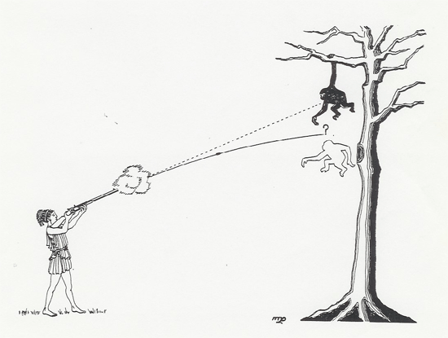

Monkey Hunter Demo
An awesome demo...
http://www.youtube.com/watch?v=cxvsHNRXLjw
https://www.youtube.com/watch?v=0jGZnMf3rPo
The hunter aims at the monkey in the tree. Just as the hunter shoots the gun, the monkey lets go and falls due to gravity. What happens?
The bullet hits the tree right at the monkey’s original position.
The bullet hits the tree above the monkey’s position as he is falling.
The bullet hits the monkey as he is falling.
The bullet hits the tree below the monkey’s position as he is falling.

